Slide 1

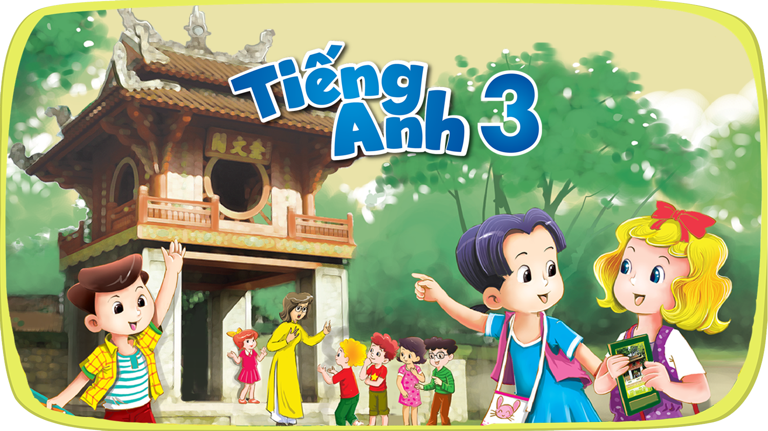


Slide 2



6
Our school
LESSON 1

Slide 3
I. OBJECTIVES.
By the end of the lesson, pupils will be able to:
1. Language.
use the words school, classroom, library, playground in the sentence pattern:
Is this our ……………………..?
Yes, it is. / No, it isn’t.
use Is this our…….....................?
Yes, it is. / No, it isn’t. to ask and answer questions about their school.
2. Core competencies.
- teamwork, reliability, motivation, communication and initiative. .
3. General competencies.
- Listening: listen and recognize the names, then repeat.
- Critical thinking: talk about school, answer yes/ no questions.
- Oral communication: talk about schools and places in the room, answer some questions.
- Self-control & independent learning: perform listening tasks.
- Communication and collaboration: work in pairs or groups.
4. Attributes.
- Diligence: complete learning tasks
- Leadership: collaborate with teachers to enhance language skills

Slide 4
Warm-up

Slide 5


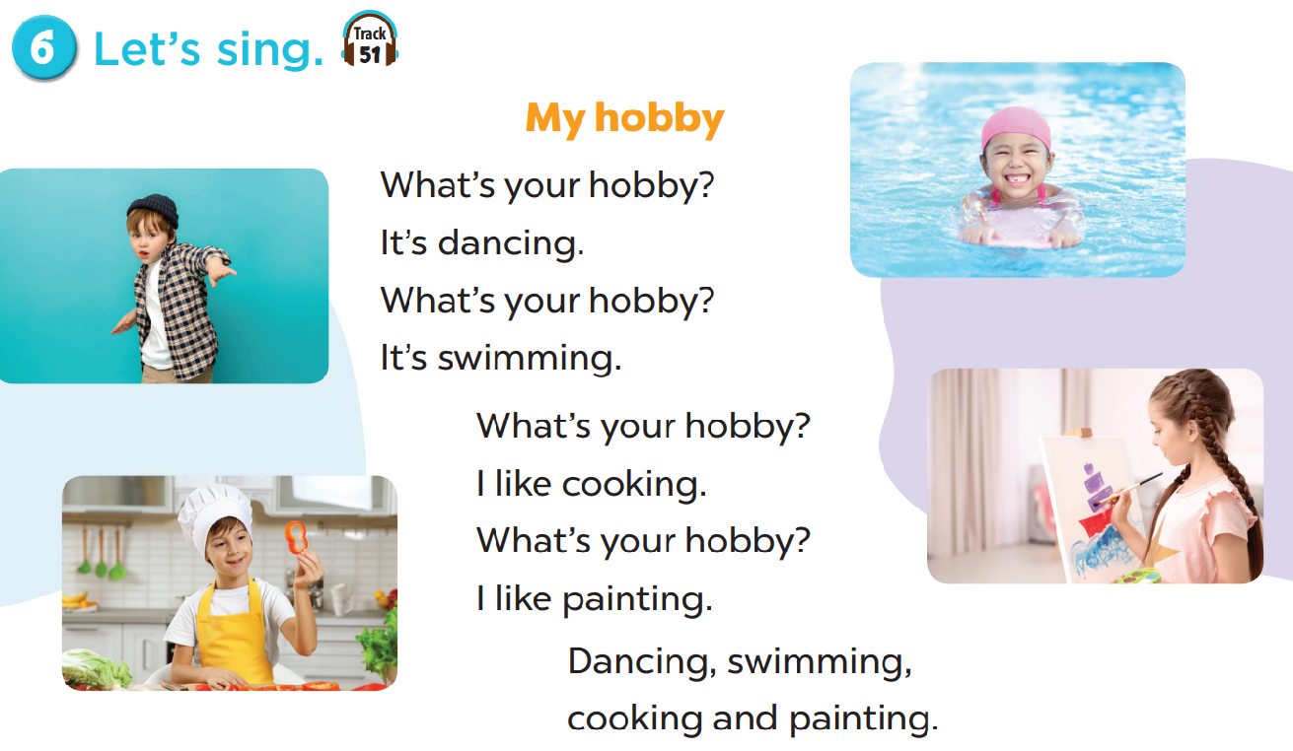
Let’s sing.

Slide 6
1. Look, listen and repeat.

Slide 7
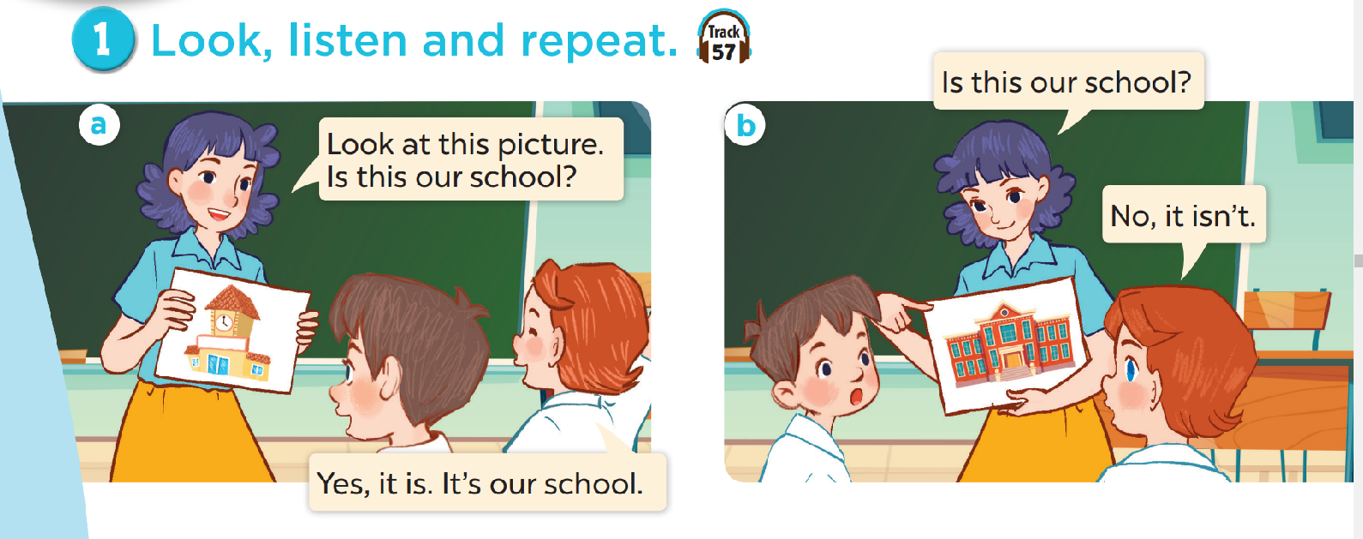

Slide 8
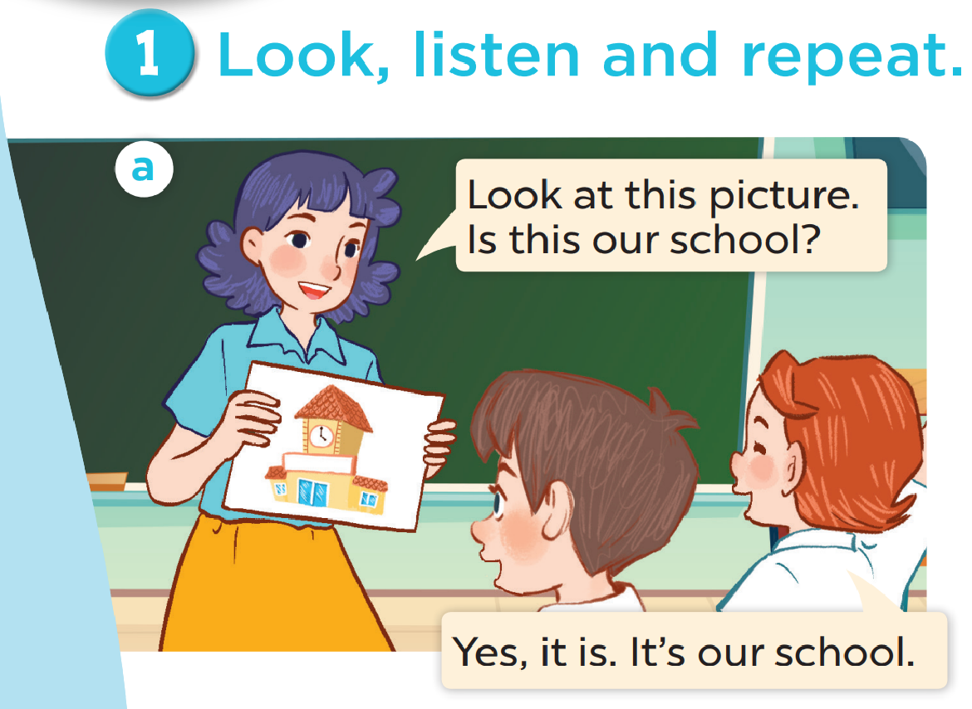

Slide 9
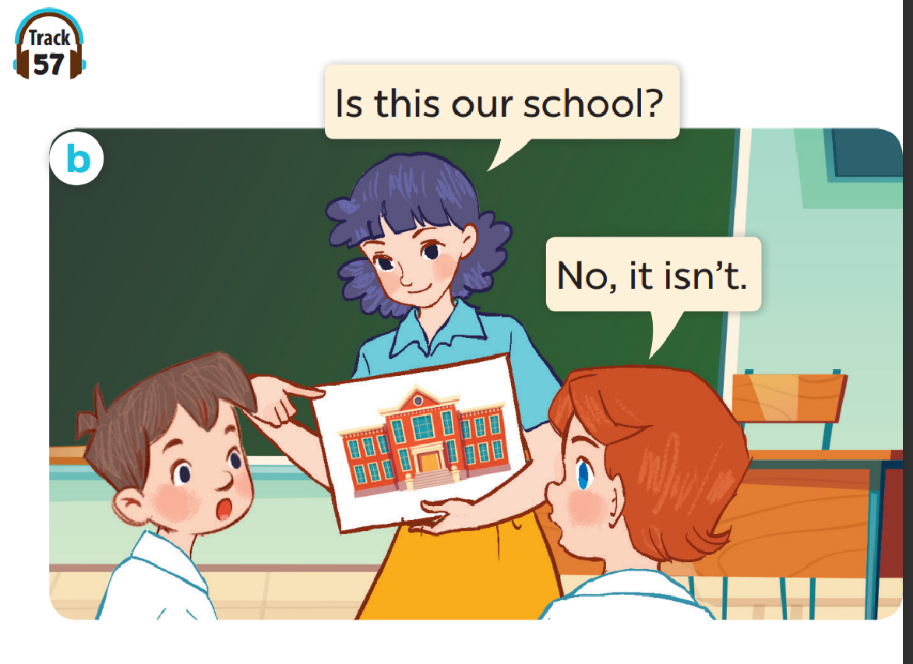

Slide 10
New words

Slide 11
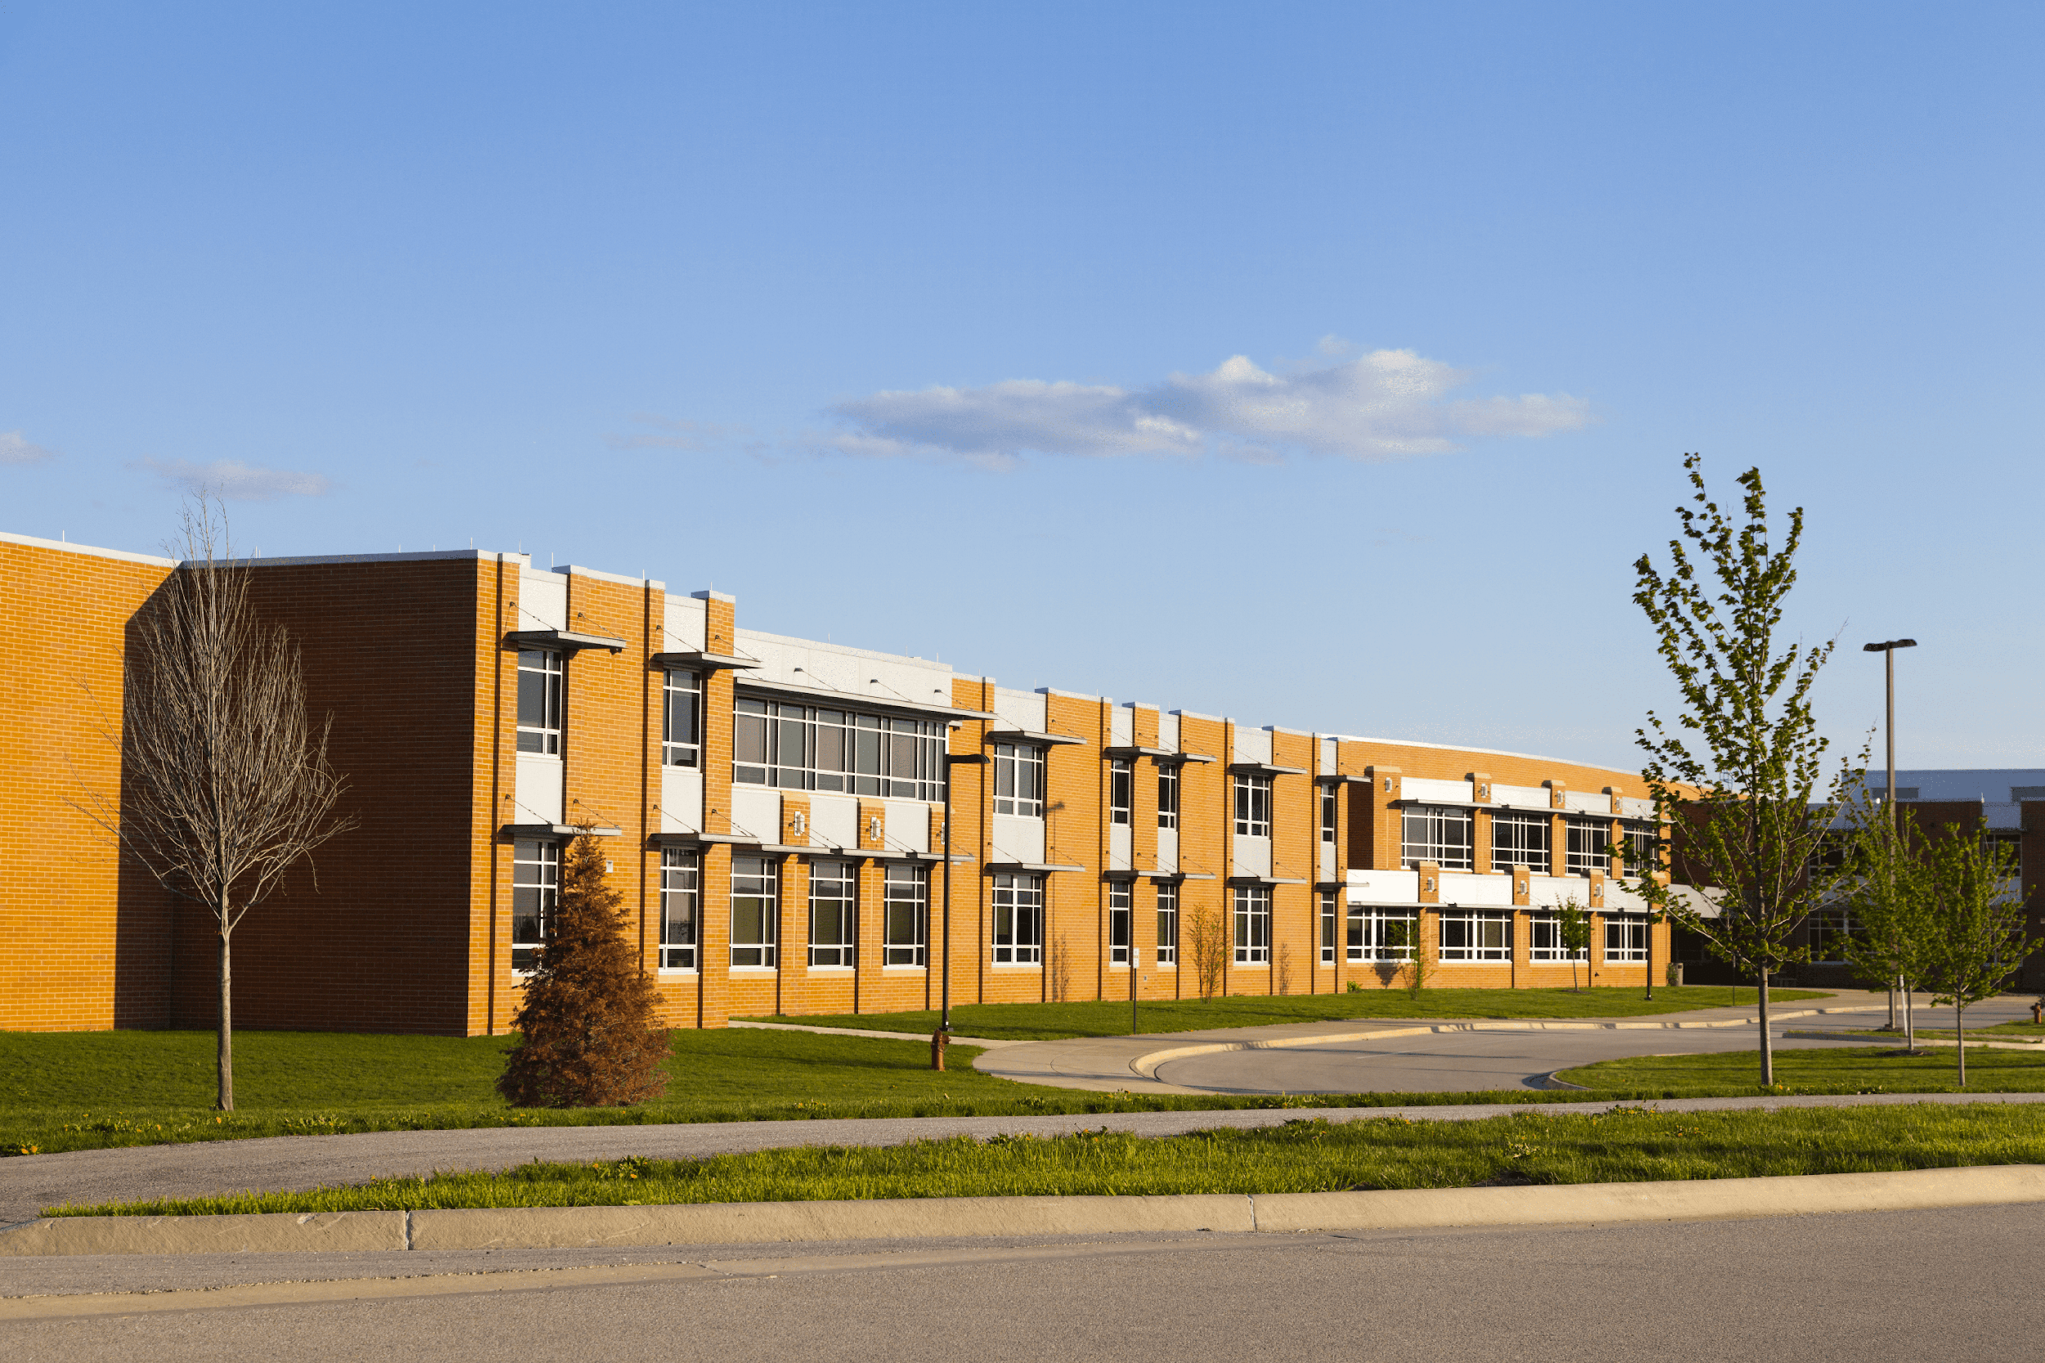
school

Slide 12
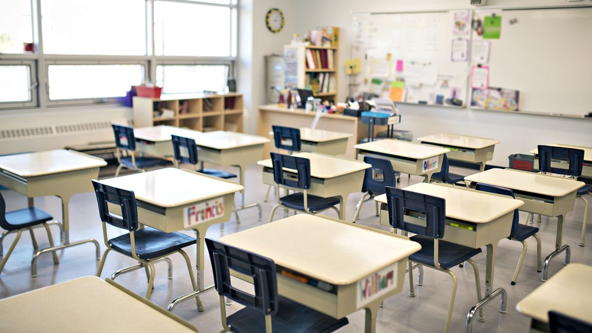
classroom

Slide 13
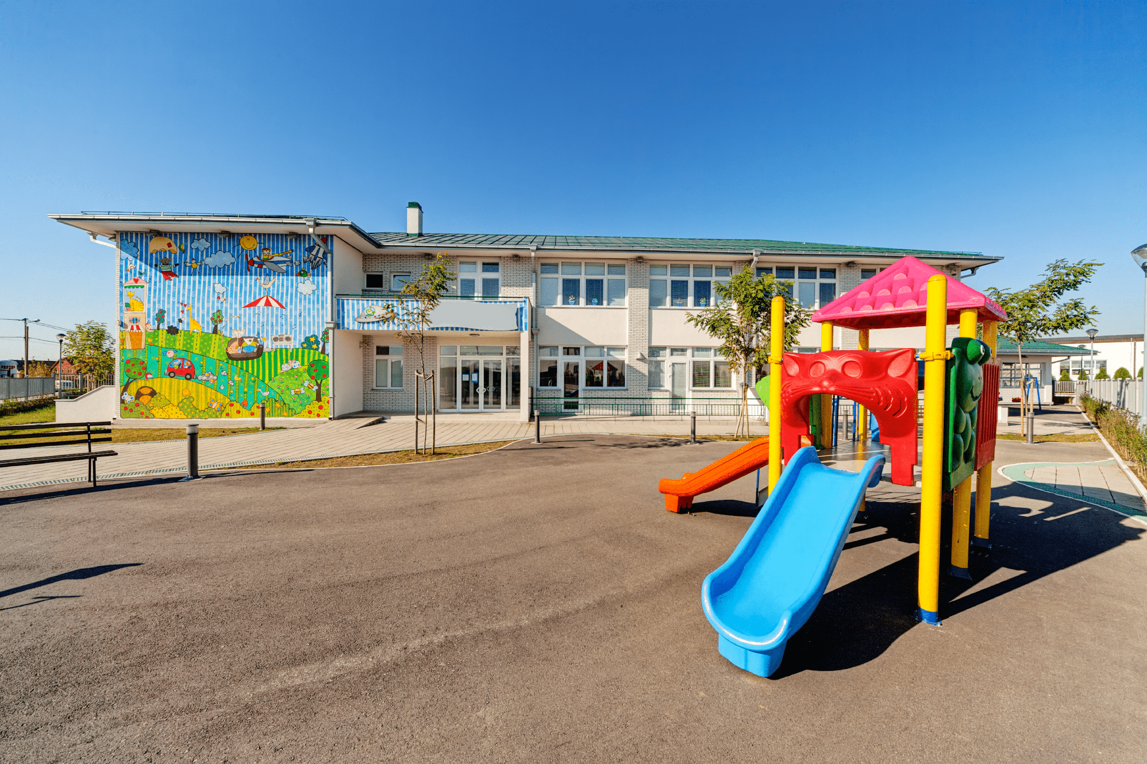
playground

Slide 14
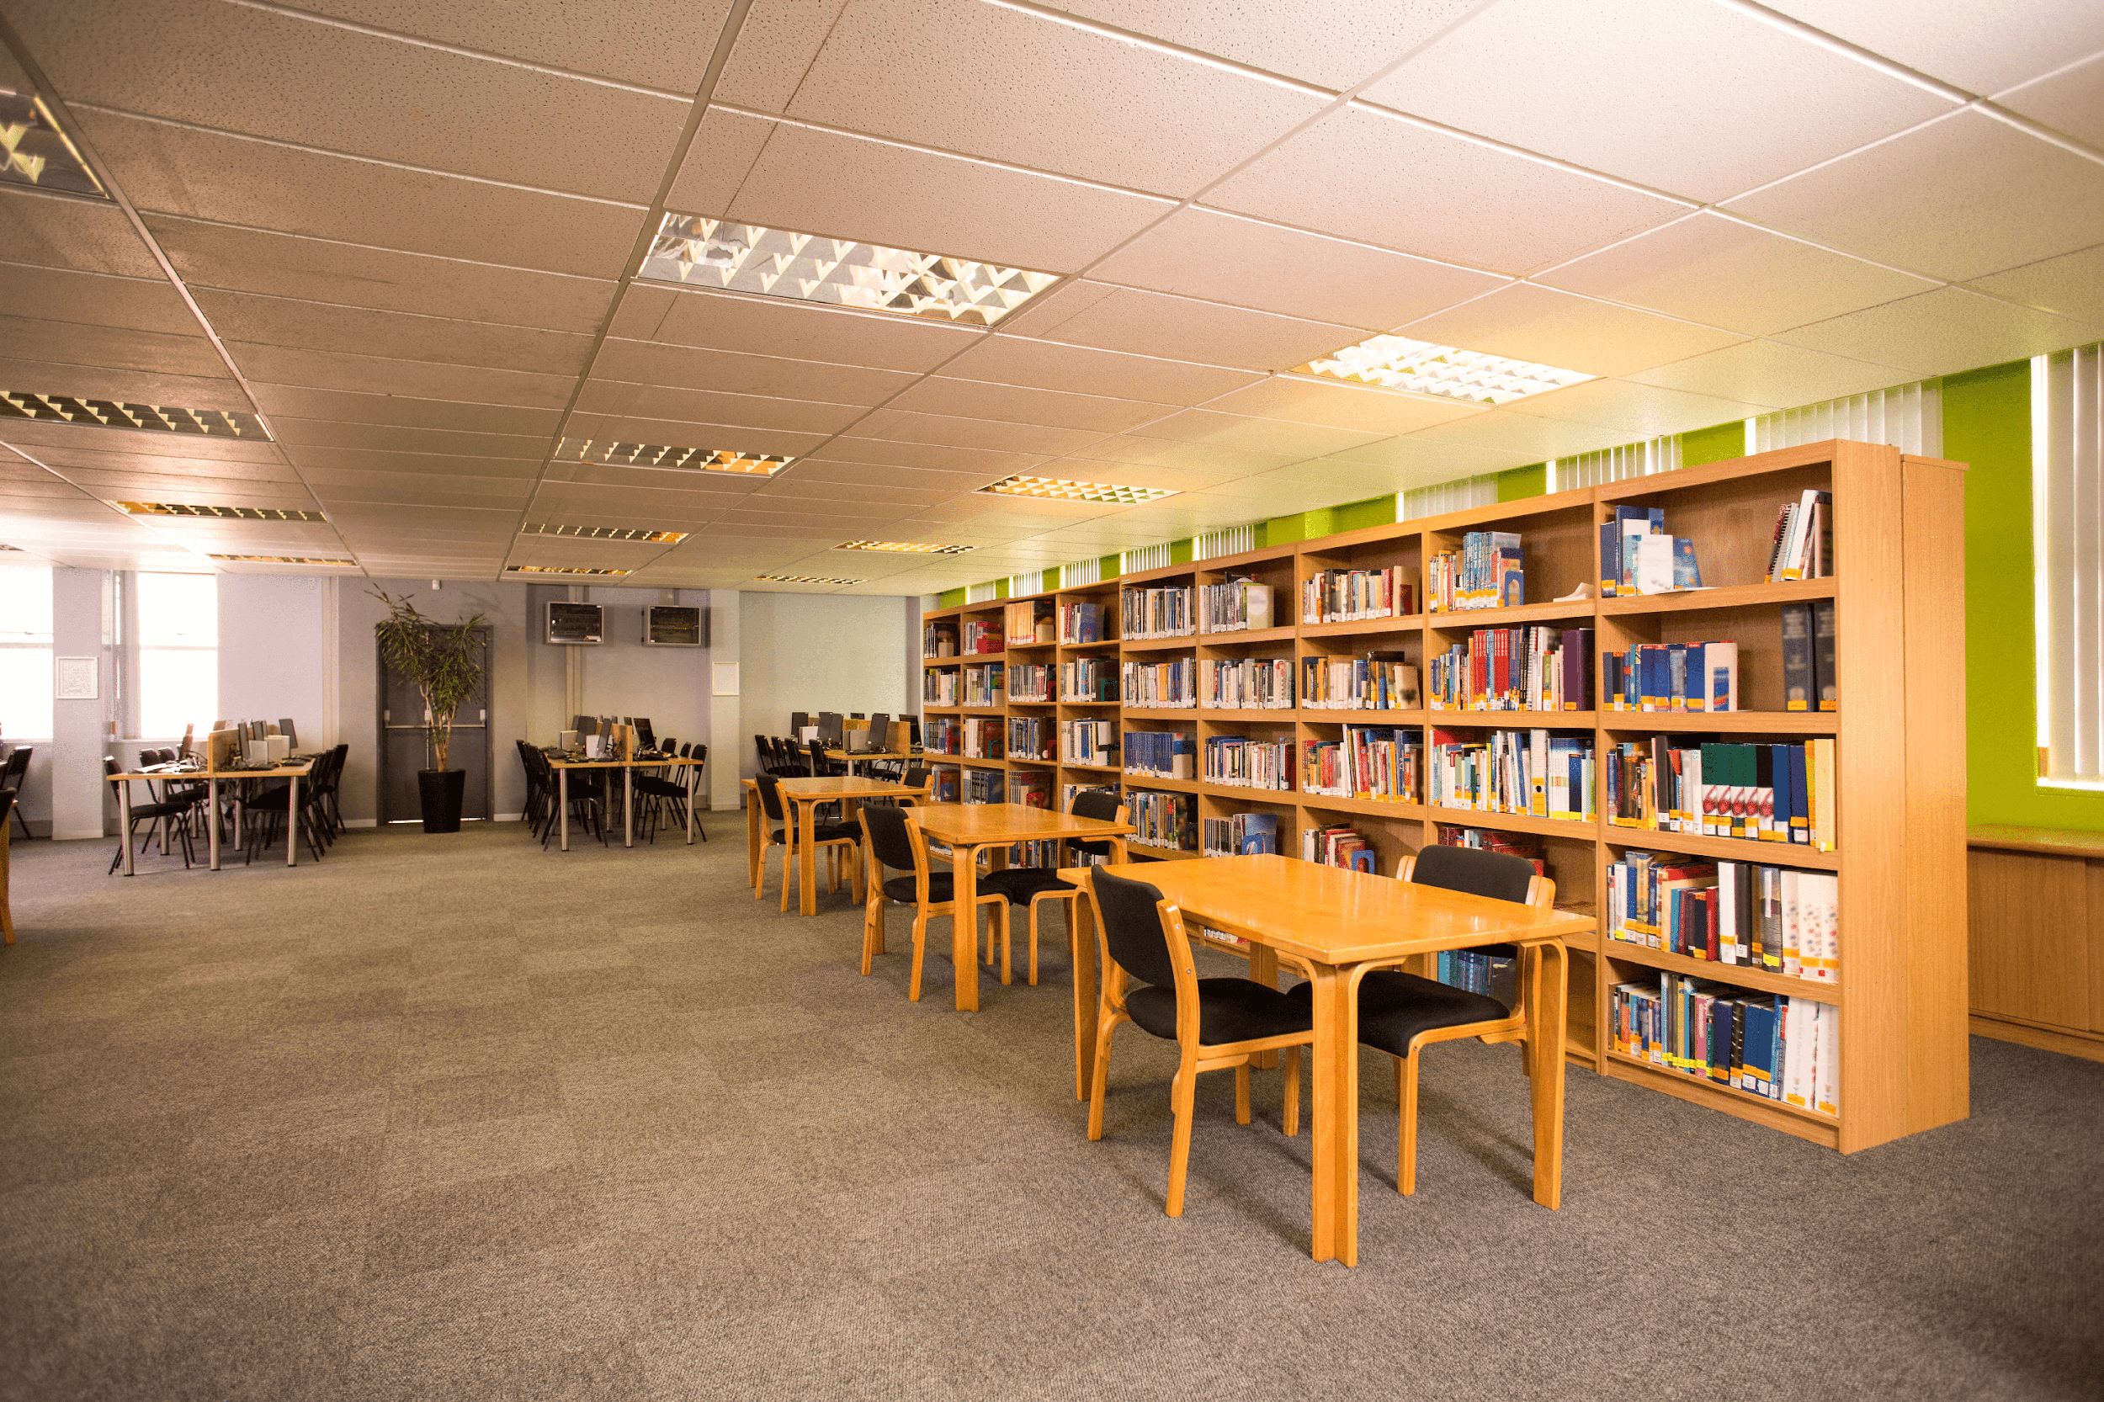
library

Slide 15
Look and guess.

Slide 16
playground

Slide 17
classroom

Slide 18
library

Slide 19
school

Slide 20
2. Listen, point and say.

Slide 21
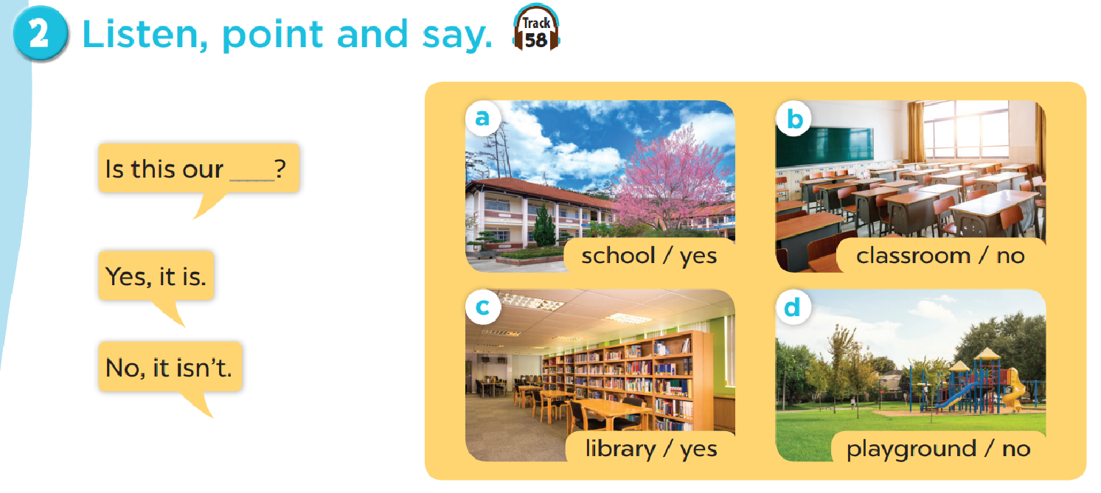
Work in pairs. Practise.

Slide 22


Is this our classroom?
Yes, it is.
No, it isn’t.

Slide 23
Is this our library?
Yes, it is.
No, it isn’t.

Slide 24
Is this our playground?
Yes, it is.
No, it isn’t.

Slide 25
4. LISTEN AND TICK.

Slide 26
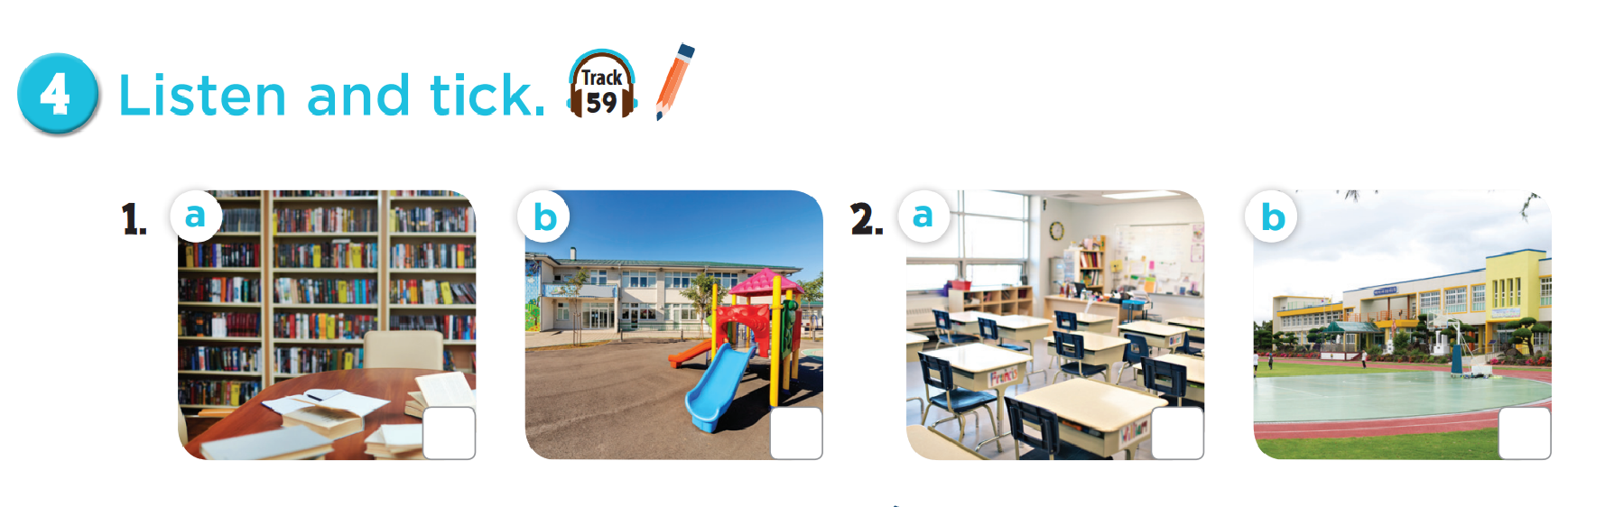

Slide 27
Fun corner

Slide 28







5
10
15
20
15
25
10
🡪

Slide 29
Read and choose.
………… this your classroom?
Is
Is
Are

Slide 30
Read and choose.
That is our…………………………
playground
playground
classroom

Slide 31
Read and choose.
Is ……….your classroom?
they
that
that

Slide 32
Read and choose.
Is that your library?
Yes, it isn’t.
Yes, it is.

Slide 33
Read and choose.
Is that ………….school?
look
your
your

Slide 34
Read and choose.
Is this our playground?
No, it isn’t.
No, it is.

Slide 35
Read and choose.
Is that your……………..?
library
school
school

Slide 36
Let’s play a game.
No
Yes
classroom
10 points
No
4
library
5 points
3 points
2
bomb
1
Yes
3
playground
school
school
10 points
school
5
library
- 3 points
6
Yes
1 point
Yes
7
playground
No
Yes
4 points
10 points
8
Notes:
Gv chia 2 đội.
Hs chọn số, 1 bạn đặt câu hỏi, 1 bạn trả lời với từ cho sẵn và nhận điểm

