Slide 1



Slide 2





8
Period 1

Slide 3
I. OBJECTIVES.
By the end of the lesson, pupils will be able to:
1. Language.
use the words blue, brown, red, yellow related to the topic “colours”;
- Use What colour is it? – It’s _______ to ask and answer questions about colours of school things;
- Listen to and demonstrate understanding of simple exchanges related to the topic “Colours”
- Read and write about the colours of school things.
- Listen to and demonstrate understanding of simple exchanges related to the topic “Colours”
2. Core competencies.
- Teamwork, motivation, communication, planning and organization
3. General competencies.
- Listening: look, listen and repeat
- Critical Thinking: listen, point and say
- Oral Communication: let’s talk
- Communication and collaboration: work in pairs or groups
3. Attributes.
- Diligence: complete learning tasks
- Honesty: tell the truth about feelings and emotions
- Leadership: collaborate with teachers to enhance language skills

Slide 4

Warm-up and review

Slide 5




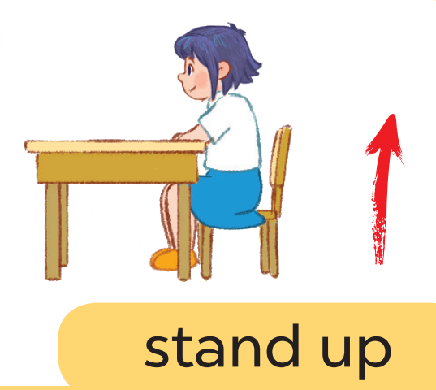


Game: Listen and choose

Slide 6
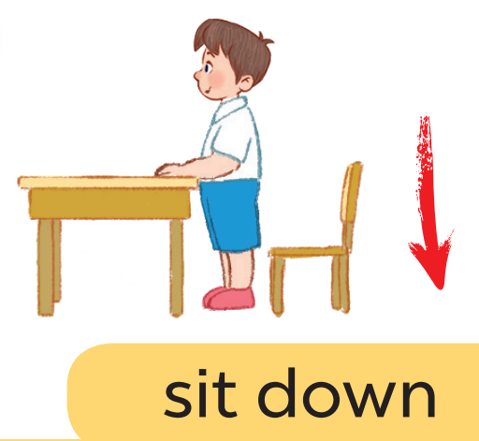
Game: Listen and choose

Slide 7
Game: Listen and choose

Slide 8
Game: Listen and choose

Slide 9
Game: Listen and choose

Slide 10
Game: Listen and choose

Slide 11
Game: Listen and choose

Slide 12
Game: Listen and choose

Slide 13
1.Look, listen and repeat.

Slide 14
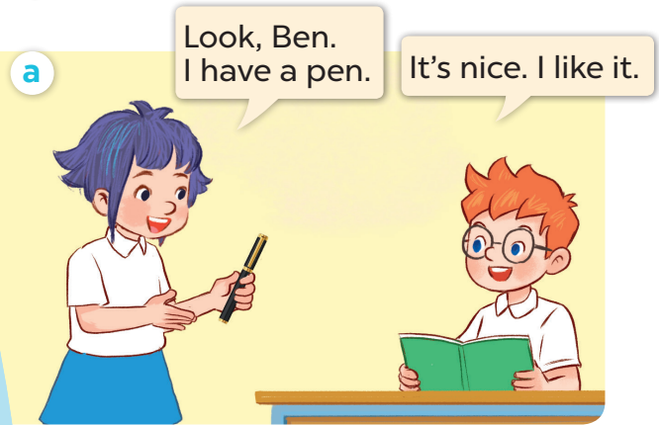
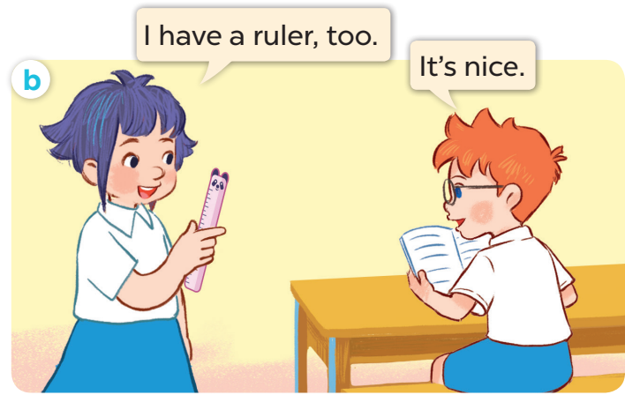

Slide 15
2. Listen, point and say.

Slide 16
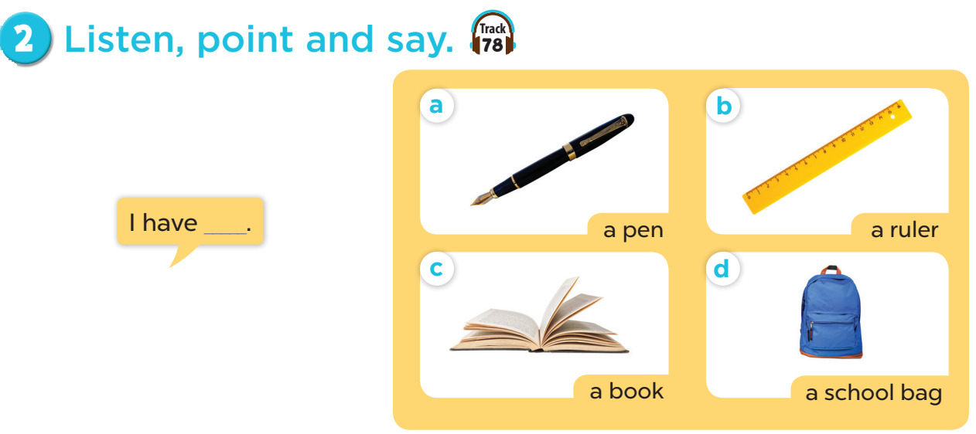

Slide 17


Slide 18
4. Listen and tick.

Slide 19
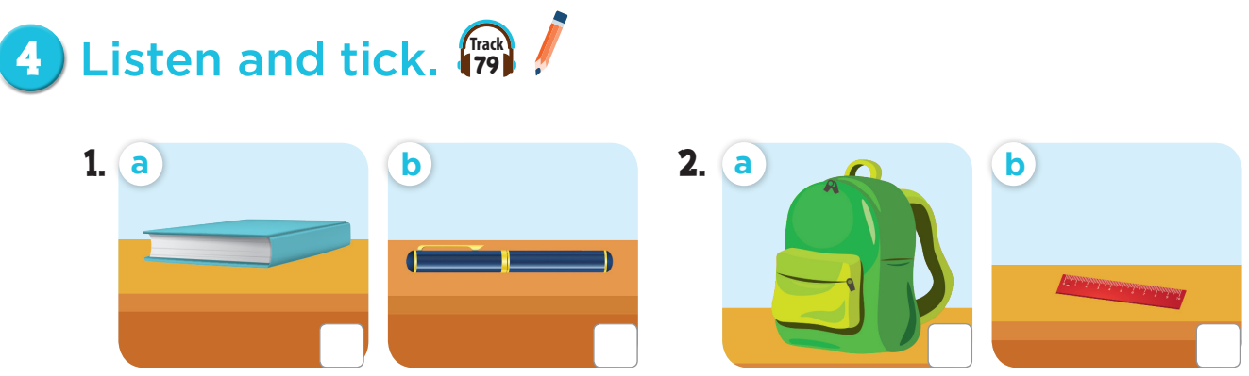

Slide 20
✓
✓

Slide 21
Let’s play:
Who says fast?
I have a book!
Notes:
Game: Who says fast? Teacher points to the picture, pupils say it as fast as they can. This can be played individually or in teams.

Slide 22


Game:
Notes:
Game: Slap the board.
- Divide the class into four teams.
- Stick the pictures of activities on the board.
- T says a sentence, a pupil from each team has to point/slap the right picture and says the sentence again. The faster pupil will get points for their team.

Slide 23
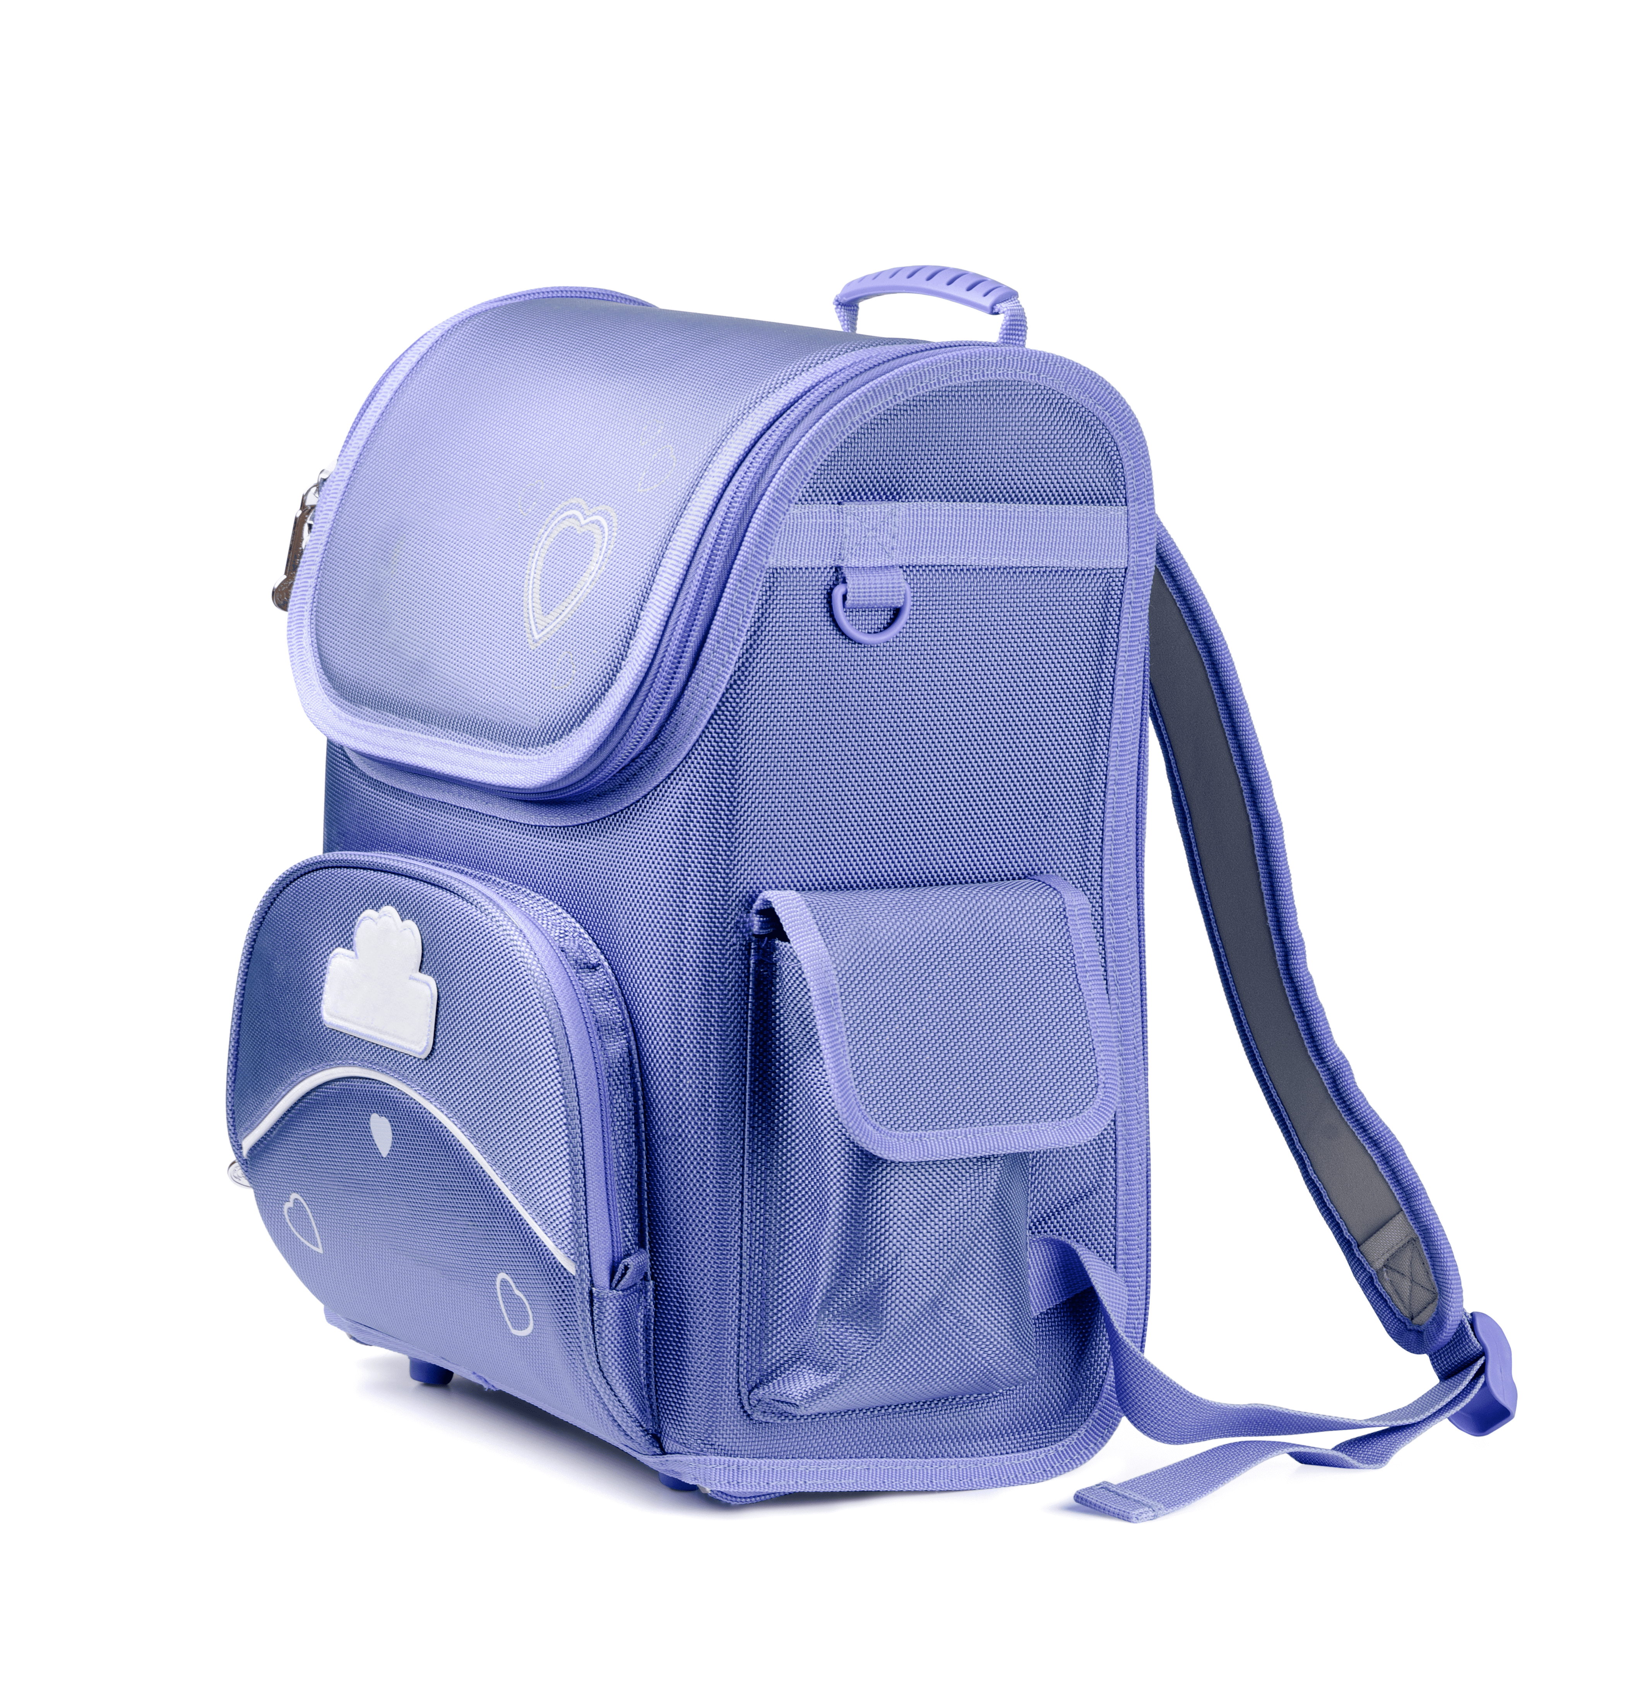

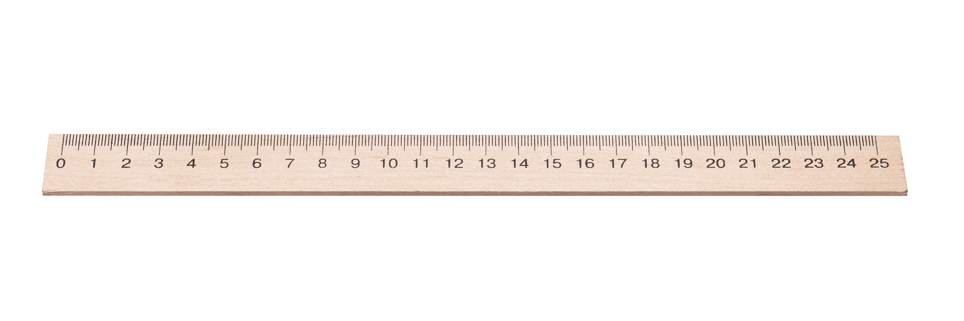

I have a ruler!
I have a ruler!
Notes:
Game: Slap the board.
- Divide the class into four teams.
- Stick the pictures of school things on the board.
- T says a sentence, a pupil from each team has to point/slap the right picture and says the sentence again. The faster pupil will get points for their team.

Slide 24
Game: Let’s move and say!

Slide 25
















I have a pencil!
Go back 1 space
Go back 1 space
Go forward 1 space
Back to
start!
Notes:
Let’s move and say!
- Get 2-3 pupils to play at the same time.
- Each pupil tosses a dice then moves accordingly.
- When he/she gets to the space, they have to do the requirements. Whoever gets to the last place first is the winner.

